Slide 1
CINEMA SPHERE

Slide 2


PRESENTED BY
P RAMESH
(B.E. Electronics and Communication Engineering)
SAKSHI JAISWAL
(B.E. Electronics and Communication Engineering)

Slide 3
CONTENTS
INTRODUCTION
TECHNOLOGIES USED
BACKEND ARCHITECTURE
WORKFLOW
LANDING PAGE
HOW IT WORKS?
FUTURE ENHANCEMENT

Slide 4
INTRODUCTION
Welcome to Cinema Sphere, Cinema Sphere is a revolutionary movie application designed to enhance your movie-watching experience. The objective of our movie application is to provide users with a seamless and enjoyable experience for discovering, purchasing, and managing their favorite movies.

Slide 5









TECHNOLOGIES USED

Slide 6
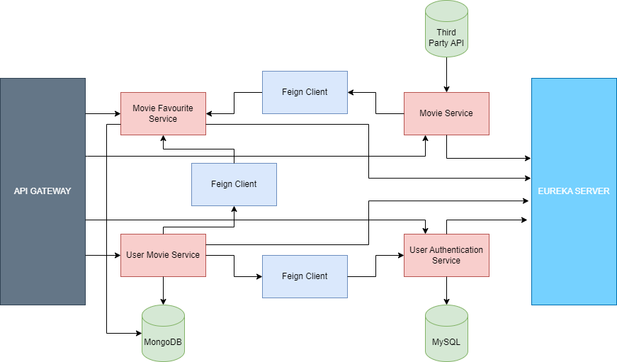
BACKEND ARCHITECTURE

Slide 7
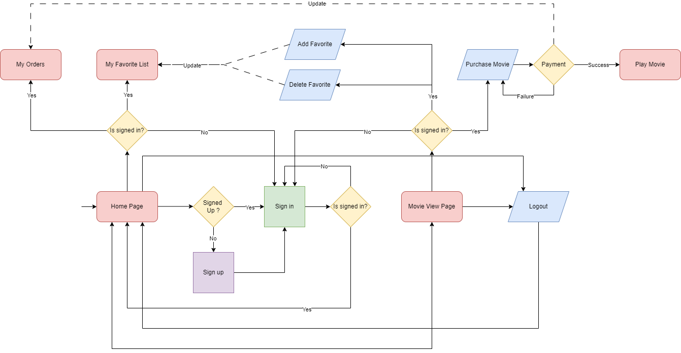
WORKFLOW

Slide 8
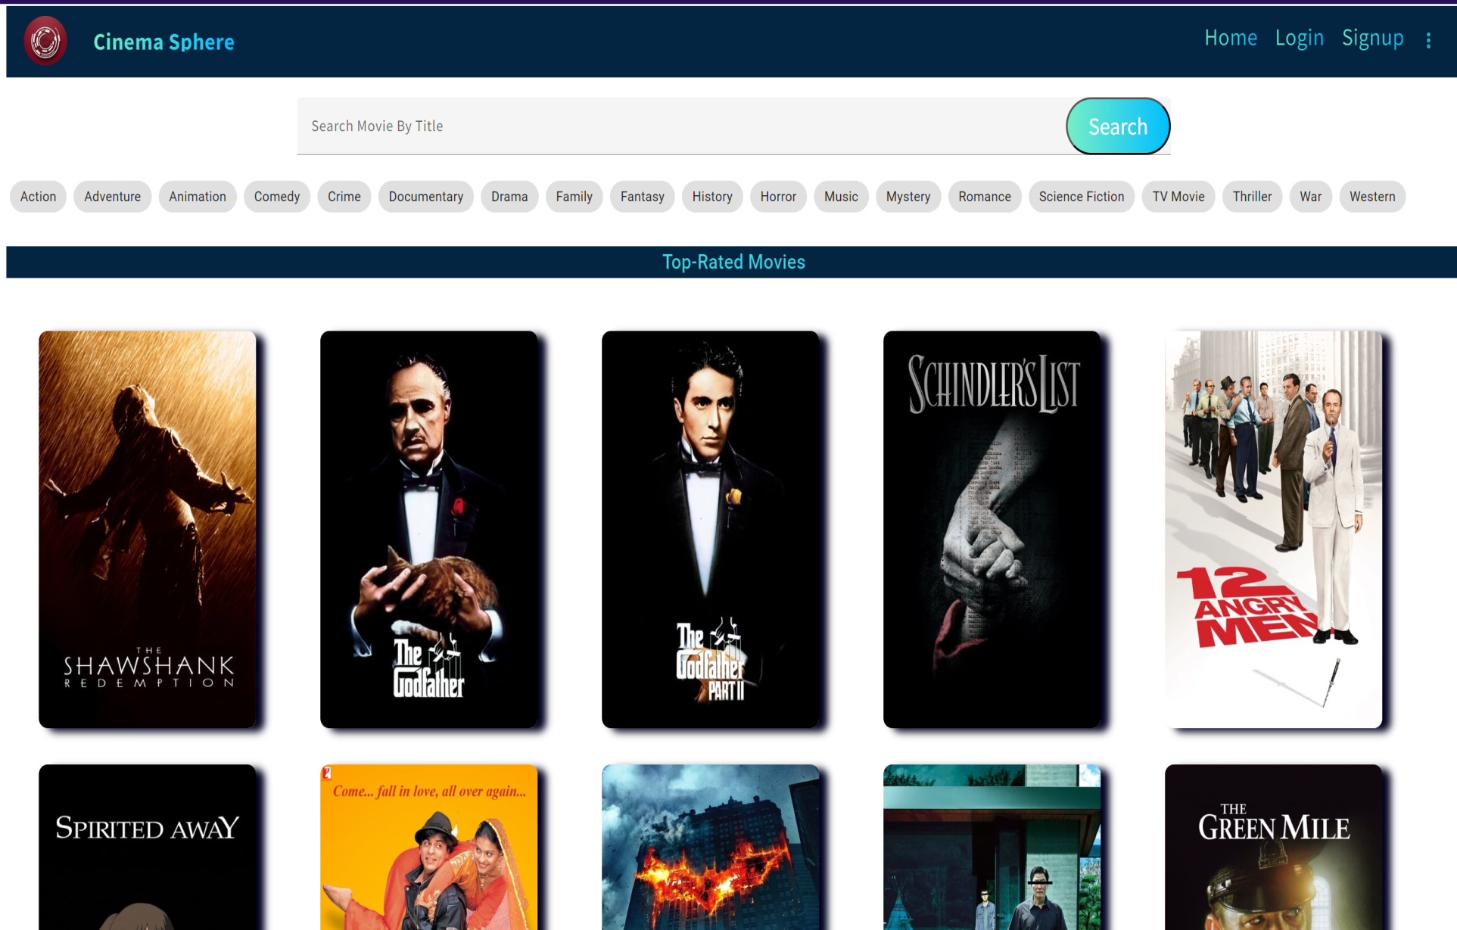
LANDING PAGE

Slide 9
HOW IT WORKS ?
Sign Up or Log In: Create an account or log in with your existing credentials to unlock the full potential of Cinema Sphere.
Discover Movies: Browse through our extensive collection of movies or use our advanced search filters to find the perfect film for any occasion.
Add to Favorites: Mark movies as favorites to revisit them anytime.
Selection: Users can select specific movies they wish to purchase by browsing through the catalog
Purchase Process: Once users have selected a movie they want to buy, they can initiate the purchase process within the app.
Payment Options: Users can choose the payment option that best suits their preferences and complete the transaction seamlessly.
Instant Access: Upon successful completion of the purchase, users gain instant access to the purchased movie within the app.

Slide 10
FUTURE ENHANCEMENT
Email Verification
Personalized Recommendations
User Reviews and Ratings
Integrate TV shows
Enhance Search Functionality

Slide 11



Slide 12
BIBLIOGRAPHY
https://developer.themoviedb.org/
https://www.youtube.com/watch?v=oKHJUO4VFZA
https://www.bezkoder.com/integrate-angular-spring-boot/

Slide 13


THANK YOU !

